Slide 1

Vel Tech Rangarajan Dr. Sagunthala R&D Institute of Science and Technology
School of Computing
Department of Computer Science and Engineering
10211CS224 / FULL STACK APPLICATION DEVELOPMENT (JAVA)
PROJECT REVIEW : MILESTONE PROJECT – 2
Date: 22-04-2026
Smart Campus Event Management System
SDG 4 – Quality Education
Presented By:
V.Vaishnavi– VTU26447– 23UECS0439
Courses Handling Faculty:
Dr.S.HEMAMLINI,M.E.,PH.D.,

Slide 2
INTRODUCTION
1
Campus events are often managed manually, leading to confusion, missed updates, and inefficient coordination. Students may miss opportunities due to lack of a centralized information system. This project is important as it digitizes event management, making it organized and easily accessible. It improves communication between organizers and participants in real time. The system has real-world relevance in colleges, universities, and institutions conducting frequent events. It reduces paperwork and saves time through automation. The Smart Campus Event Management System allows users to view, create, and register for events online. It provides a centralized platform for efficient event planning, management, and participation.
2
3
4
5
6
7
8
9

Slide 3
PROBLEM STATEMENT
In many campuses, event management is still handled manually or through multiple unorganized platforms, leading to poor communication and missed updates. Organizers face difficulties in managing event details and tracking participant registrations efficiently, while students often lack a centralized system to discover and register for events. These manual processes increase the chances of errors, data mismanagement, and reduced participation. There is also no proper mechanism to monitor event engagement and performance. Therefore, there is a need for a simple, reliable, and automated system that centralizes all event-related activities. The proposed Smart Campus Event Management System aims to address these issues by improving efficiency, accuracy, and accessibility.
1
2
3
4
5
6
7
8
9

Slide 4
OBJECTIVE(S)
To design and develop a Smart Campus Event Management System: To create a centralized platform for managing campus events. To design a user-friendly interface for easy event access and management.
To implement an automated event management process: To enable event creation, registration, and tracking digitally. To ensure real-time updates and notifications for users.
To improve system efficiency: To streamline communication between organizers and participants. To reduce manual work and data management errors.
To evaluate performance of the system: To measure system reliability during multiple event operations. To analyze user experience and overall system effectiveness.
1
2
3
4
5
6
7
8
9

Slide 5
PROPOSED SYSTEM
1
The proposed solution is a web-based Smart Campus Event Management System that centralizes all event-related activities on a single platform. It allows organizers to create, update, and manage events digitally, while students can easily browse, register, and receive notifications about upcoming events. This system eliminates manual processes, reducing errors and improving data management. It effectively addresses issues such as poor communication, missed updates, and lack of coordination. Real-time notifications enhance interaction between organizers and participants. Compared to existing systems, it offers better automation, improved accuracy, and faster access to information. Overall, it increases efficiency, saves time, and provides a better user experience.
2
3
4
5
6
7
8
9

Slide 6
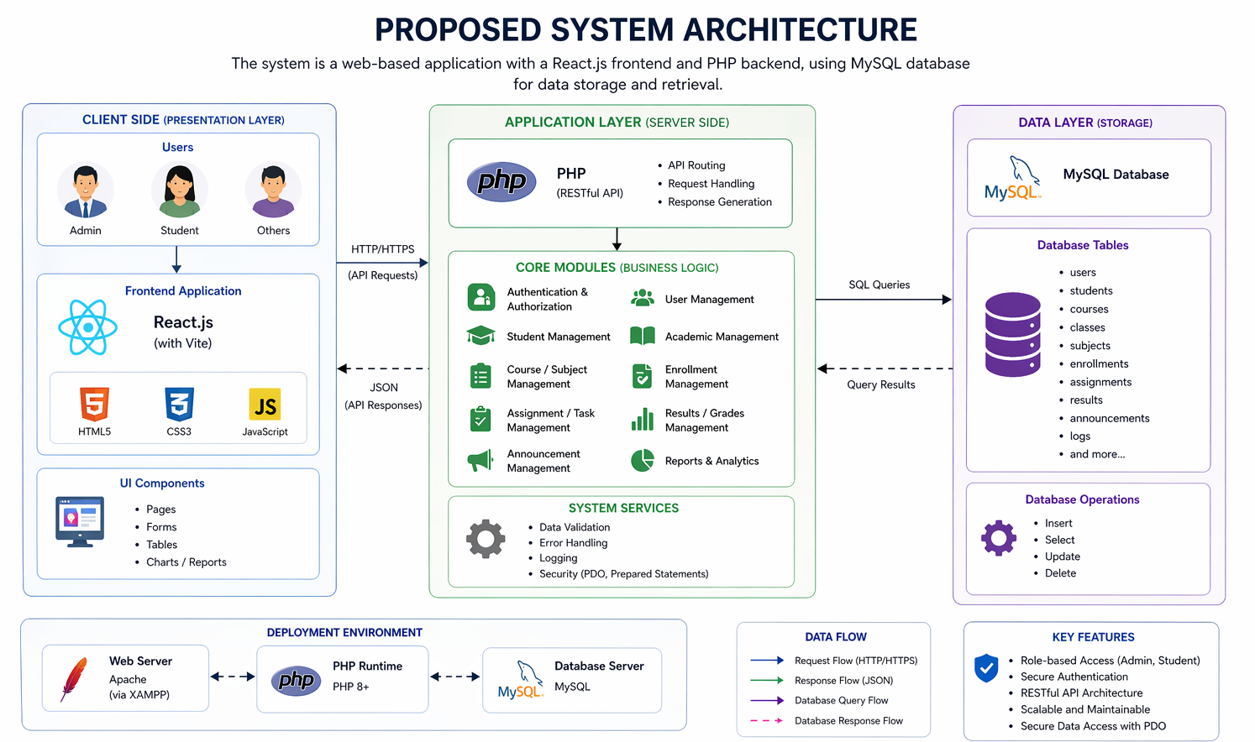
PROPOSED SYSTEM ARCHITECTURE
1
2
3
4
5
6
7
8
9

Slide 7
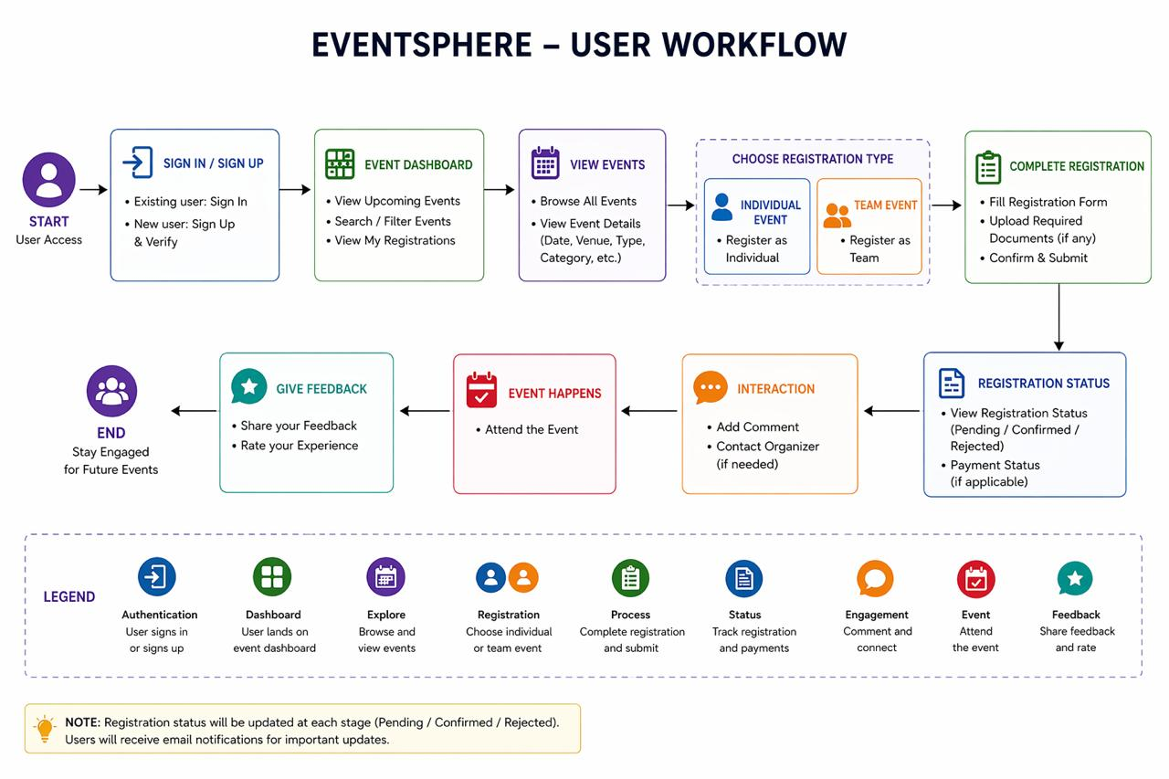
WORKFLOW
1
2
3
4
5
6
7
8
9

Slide 8
TECHNOLOGIES USED
1
1. Frontend: React.js with Vite for a fast, responsive user interface.
2. Backend: PHP for the server-side API logic and data processing.
3. Database: MySQL with PHP PDO for secure, structured data storage.
4. Languages: JavaScript (frontend), PHP (backend), SQL (data), CSS3, and HTML5.
5. Tools: XAMPP (Apache/MySQL), Node.js, and Axios for API communication.
2
3
4
5
6
7
8
9

Slide 9
MODULE DESCRIPTION
1
Module 1: User Management
Handles user registration, login, and role-based access (Admin, Organizer, Student) with secure authentication.
Module 2: Event Management
Allows organizers to create, update, delete, and manage events along with event details like date, venue, and description.
Module 3: Registration Management
Enables students to register for events, view registered events, and manage participation efficiently.
Module 4: Notification & Communication
Provides real-time notifications and updates about events, registrations, and announcements.
2
3
4
5
6
7
8
9

Slide 10
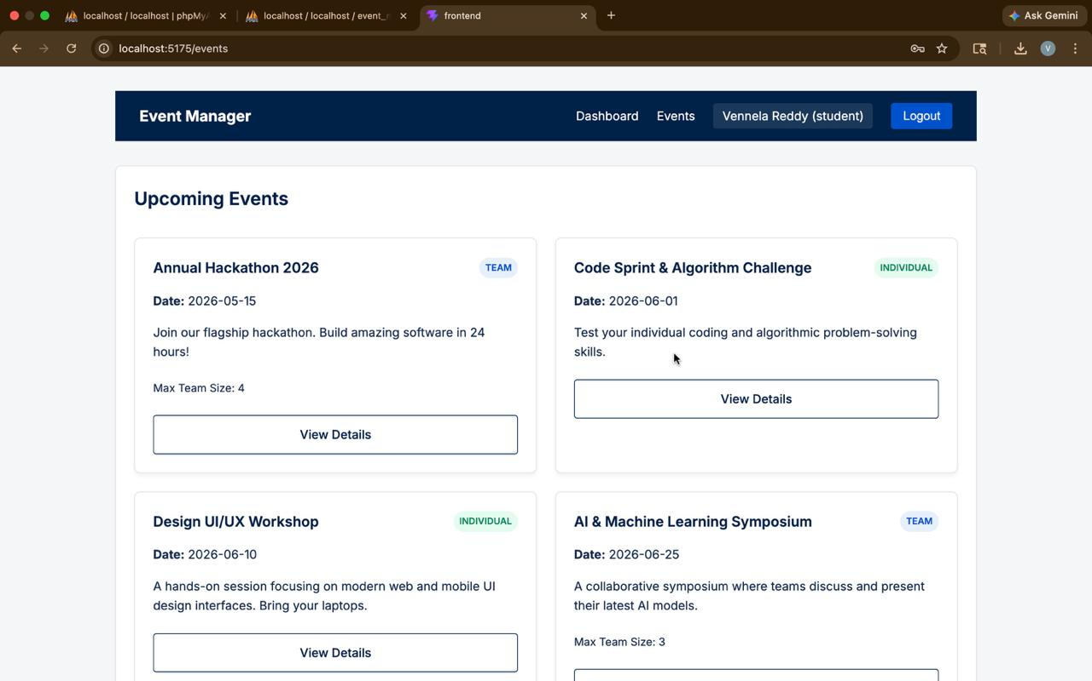
IMPLEMENTATION SCREENSHOTS
Home page:
The Home Page provides a user-friendly interface with options for login, registration, and exploring events.It highlights key features like event creation, registration, and notifications for easy access.
1
2
3
4
5
6
7
8
9

Slide 11
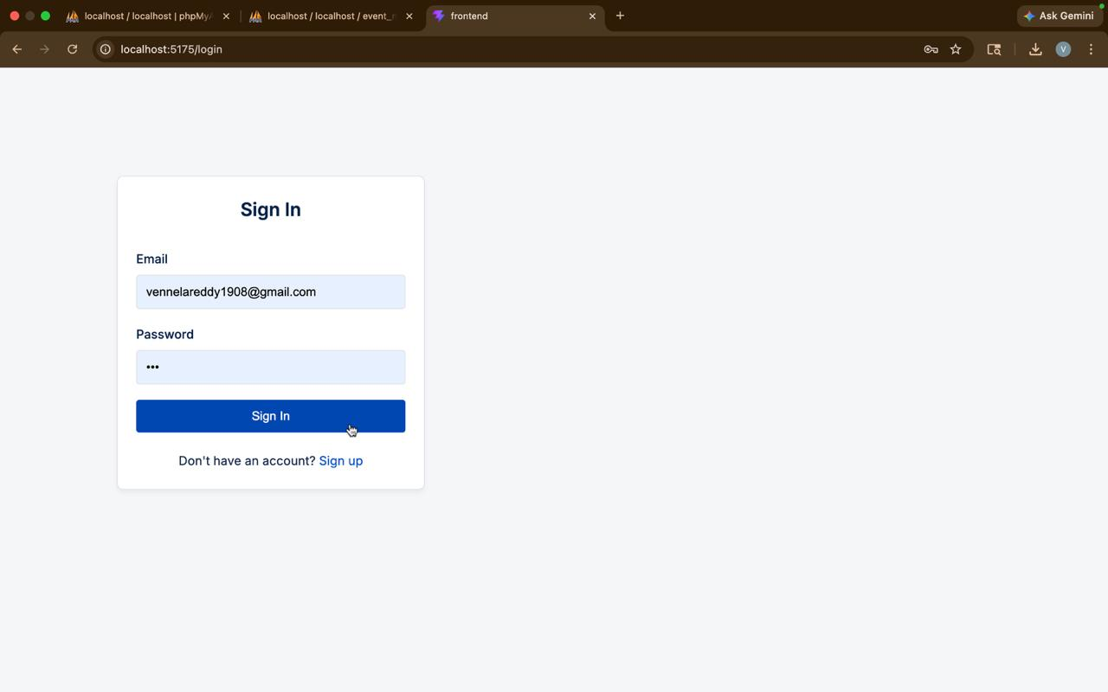
IMPLEMENTATION SCREENSHOTS
Login page:
The Login Page allows users to enter their email and password to access the system. It also provides a registration option for new users to create an account.
1
2
3
4
5
6
7
8(A)
9

Slide 12
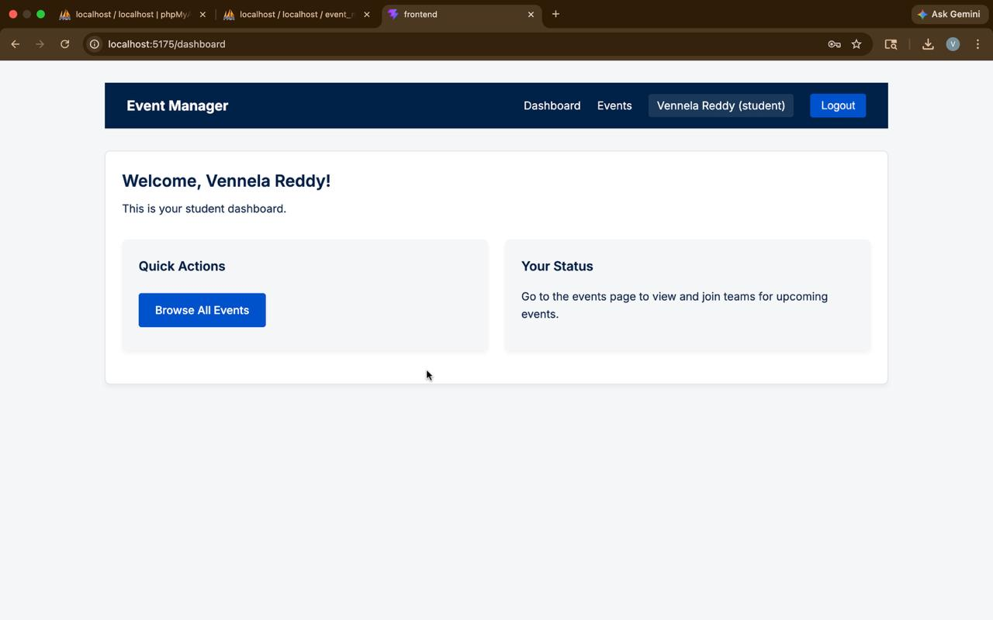
IMPLEMENTATION SCREENSHOTS
Main Module:
The second image shows a Smart Event Management System dashboard with a clean, modern interface displayed in a browser. It includes feature cards like Create Event, View Events, Register, and Logout along with summary statistics for better event tracking.
m
1
2
3
4
5
6
7
8(B)
9

Slide 13
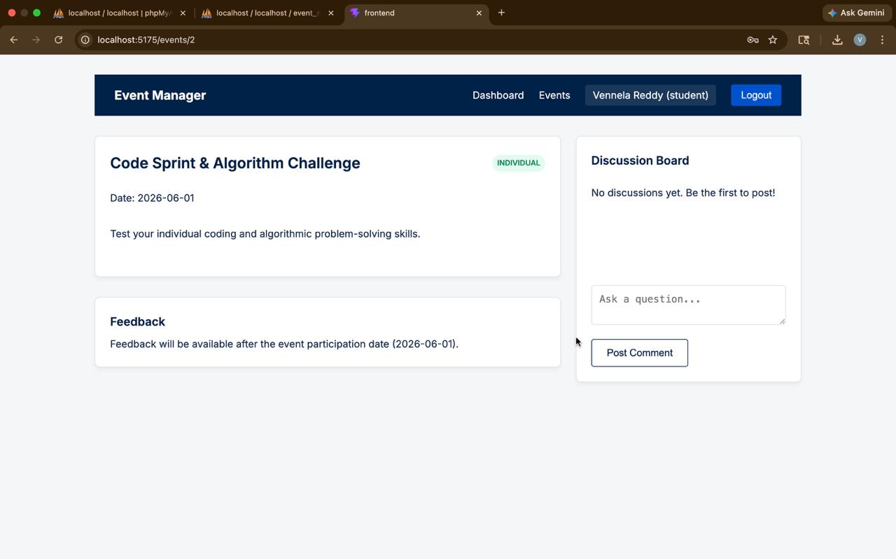
IMPLEMENTATION SCREENSHOTS
Output:
A clean and modern Smart Event Management System dashboard is shown in a browser after login. It contains four main feature cards with a professional UI layout and navigation bar.
1
2
3
4
5
6
7
8(C)
9

Slide 14
ADVANTAGES & LIMITATIONS
Improves efficiency by automating event management and reducing manual work.
Ensures secure data handling through user authentication and access control.
Provides fast processing with instant login and data retrieval.
Maintains organized data using a structured MySQL database.
Offers scalable design that can be extended with new features easily.
Easy to maintain due to modular frontend and backend structure.
Supports real-time interaction with immediate login validation.
Lightweight system that runs on simple Node.js and MySQL setup.
1
2
3
4
5
6
7
8
9

Slide 15
Thank you

